Slide 1
The Unspoken – Game Concept Presentation
Programmers: Brad, Josh, Azeem, Henry.
Designers: Daniel, Saif, Jack, Zieshan, Elliott.

Slide 2
Team Roles:-
Programmers:-
Brad - Camera and Game Manager
Henry – Turn System
Josh – Character Movement
Azeem – Interim Game Manager, Controller Systems
Designers:-
Daniel – Tank Units
Saif – Engine Implementation, Map Designs
Jack – Soldier Units
Zieshan – Environment Art
Elliott – UI and Menus

Slide 3
Basic Scope:-
With Our Given time we wish to implement:
Two Different factions (Visually and Mechanically)
Support For Multiple Players
Three Different Maps to support more than just two players
A good looking UI
Balanced Gameplay.

Slide 4
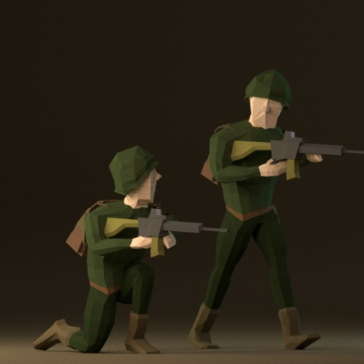
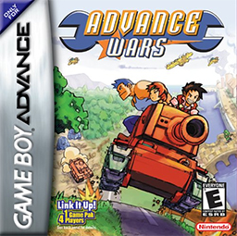
The Idea:-
The basic idea of the game is to create a fun and simplistic turn based strategy game set in an alternate history cold war.
Basically think Advance Wars in 3D.

Slide 5
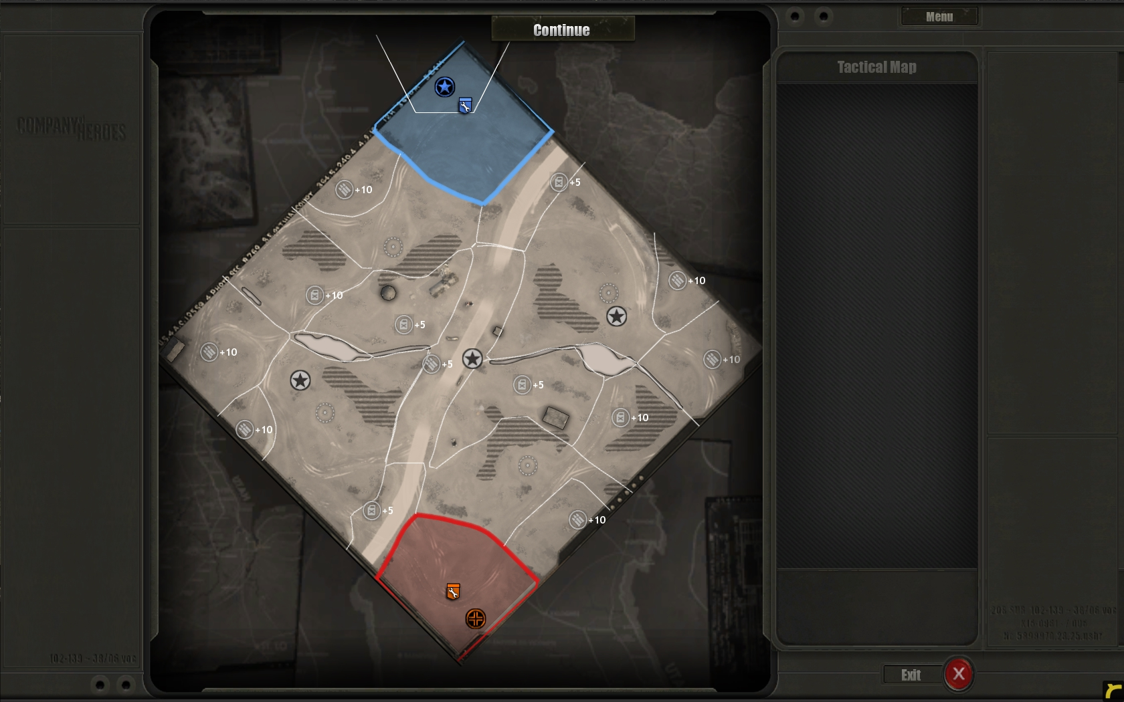
Game Structure:-
There will be 3 separate maps (Large, Medium, Small) which all support different amounts of players all of these shall be set in East/West Germany. The objectives for the players is to destroy their enemies base and win the battle.

Slide 6
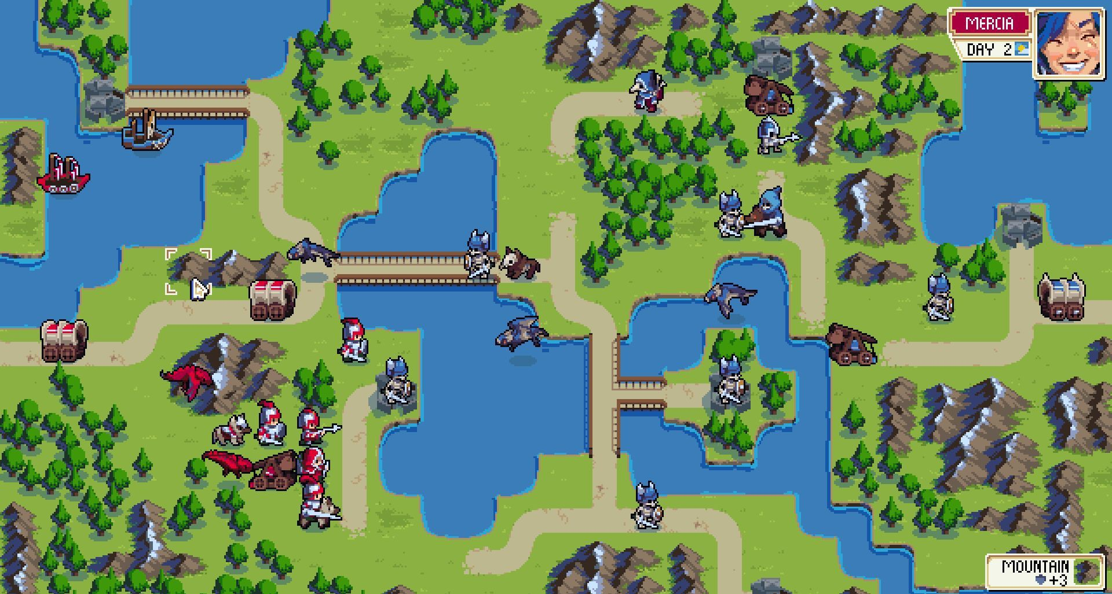
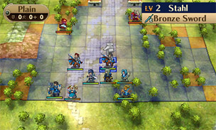
Gameplay:-
The player will be able to control the movements and attacks of units (Soldiers and Tanks) destroying other players units gives the player money to buy more units.

Slide 7
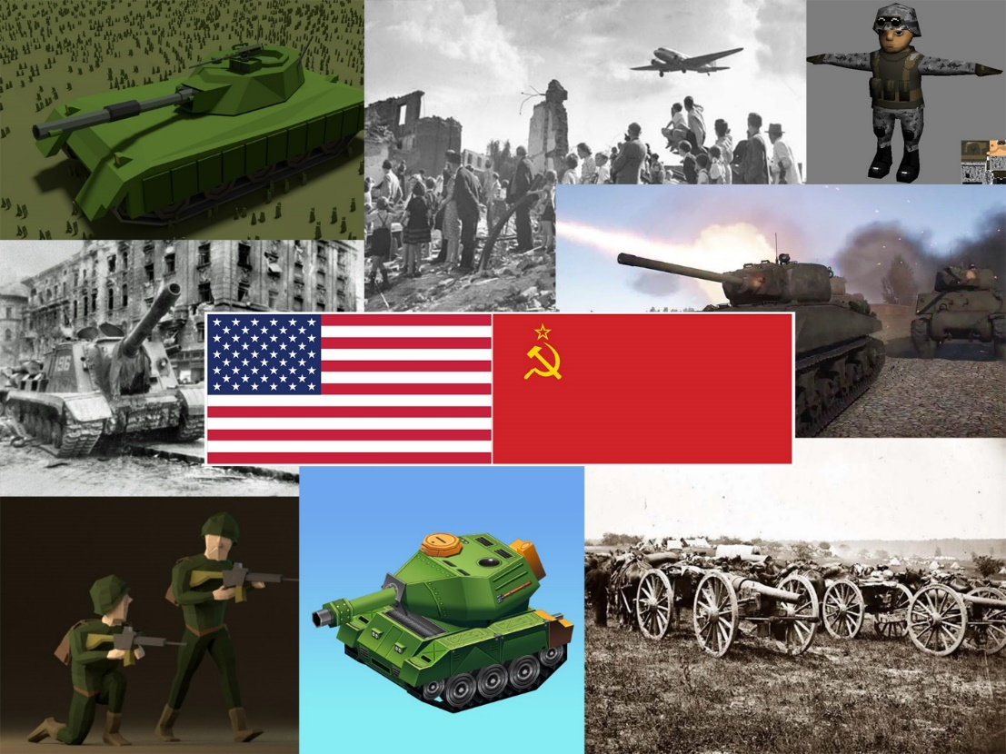
Art Style:-
3D
Low Poly
Colour Scheme Mainly Sticks to Blues and Greens

Slide 8
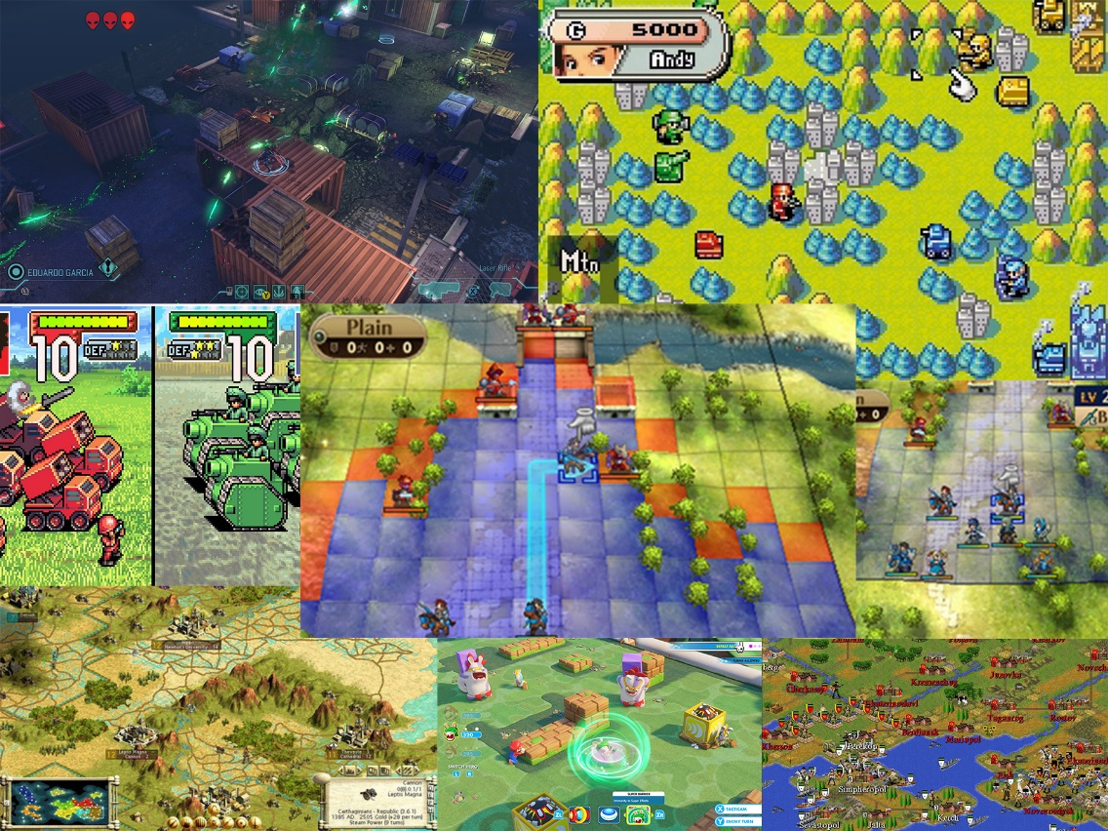
References:-
References are from similar games in terms of gameplay and or art style such as Advance Wars, Fire Emblem, Wargroove, Massive Assault etc.

